Slide 1

Application Insights
Michael Lumpp
Chief Technology Officer

Slide 2
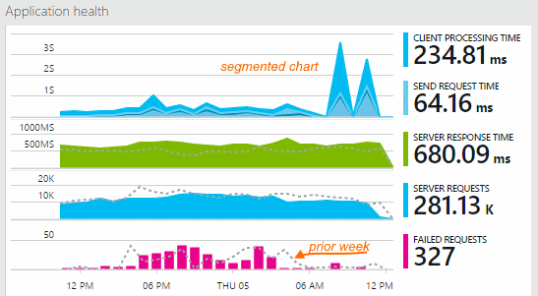
Application Insights
Powerful way to monitor your application’s usage and performance; review requests, server responses, client statistics, diagnose problems/view exceptions, track custom events, tracing, and more!
Simple Configuration – Add directly through VS2015 or via NuGet

Slide 3
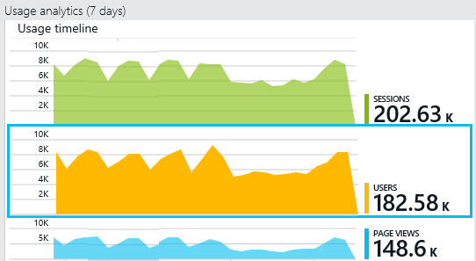
Client-side and server-side options available
Libraries for PHP, Java, Swift, Objective-C, Node.js, Ruby, Python
Low Impact - Adds 3-5% overhead in the worst case to your application
> 5% is considered a bug and a ticket is assigned to a developer

Slide 4




Track Customized Insights Within Your Application
Events – Used to track when something specific in your code takes place. Like all areas of Insights, these can have customized key-value pairs in a properties dictionary attached to the events (Correlation IDs, for example).
Traces – Can be used to diagnose problems. Diagnostic data can be put together and inspected later within the portal.
Metrics – Measure things on specific intervals, such as CPU or queue length. By default you can review the values as hourly averages.
Exceptions – Can be used to log exceptions within your application. This happens automatically when you add App Insights, however with custom code you can add additional properties/information to a NVP collection.

Slide 5
Demonstration
Code Tour in Visual Studio
Azure Portal Tour

